Slide 1



Build Interactive Web App with R & Shiny
Prepared by : Aep Hidayatuloh
Email : aephidayatuloh.mail@gmail.com
GitHub : https://github.com/aephidayatuloh
RPubs : https://rpubs.com/aephidayatuloh

Slide 2
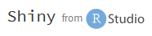
Syllabus
Pertemuan | Kompetensi Dasar | Materi
4 | Membuat tampilan shiny dengan script HTML dan CSS langsung di shiny | Mengatur tampilan dengan HTML & CSS
 |  | UI dengan tag HTML
 |  | UI dengan sebagian HTML dan shiny UI syntaks
 |  | Mengatur tampilan dengan HTML dan CSS
 | Mampu mengatur tampilan shiny dengan file CSS eksternal | Mengatur tampilan dengan file CSS eksternal
 |  | Menempatkan file CSS eksternal dalam folder project shiny
 | Menggunakan file HTML & CSS yang sudah dibuat atau template untuk tampilan shiny | Menggunakan file HTML & CSS sebagai UI
 |  | Membuat file HTML & CSS sendiri untuk tampilan shiny
 |  | Menggunakan package template shiny
 |  | Menggunakan file HTML & CSS dari template yang tersedia di internet

Slide 3

Shiny X HTML

Slide 4
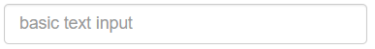
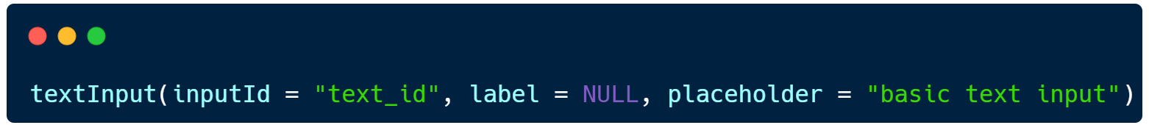
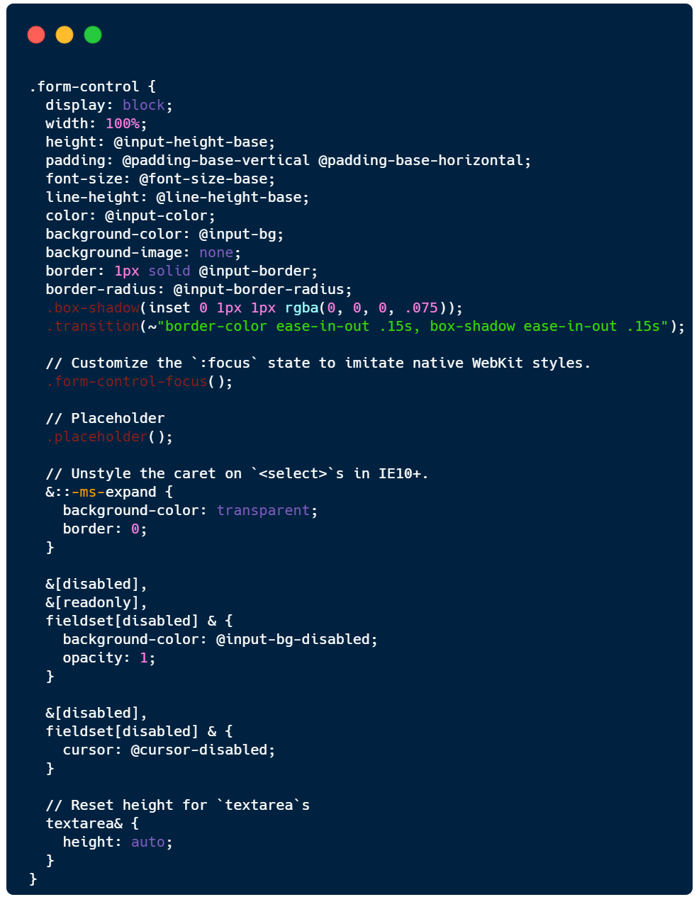
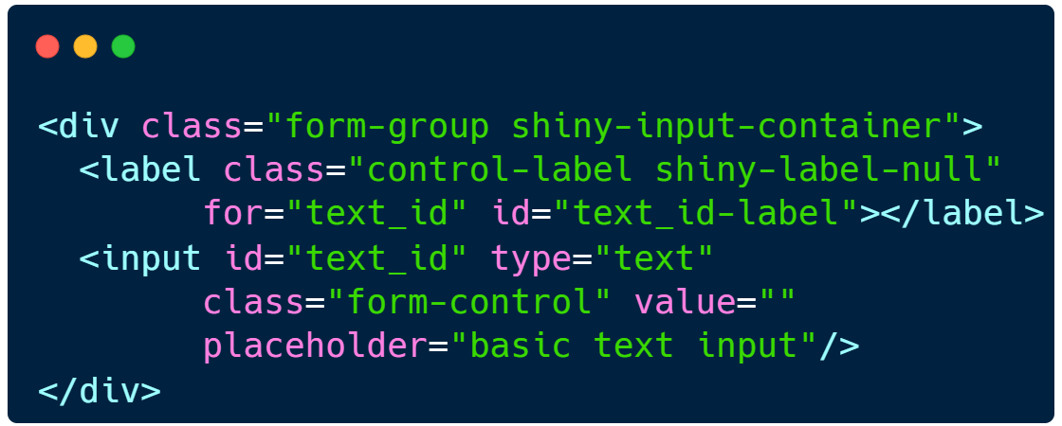
Dive Into Web Dev
Shiny apps are websites!
Basic web development:
HTML -> content
CSS -> Style
Javascript -> dynamic changes
Bootstrap: a CSS framework (a library of CSS Classes)
Shiny uses Bootstrap 3
(The world is on Bootstrap 5 now)
What you see
Shiny
HTML
CSS

Slide 5
Shiny X HTML

Slide 6
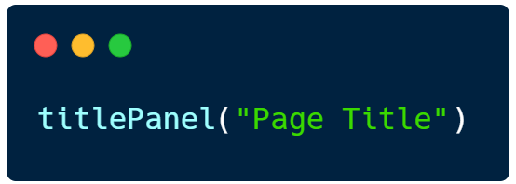
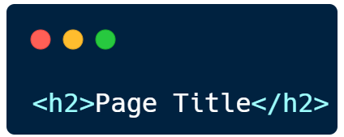
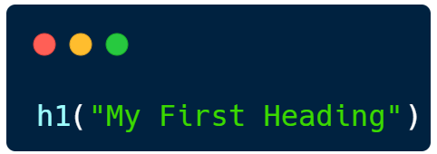
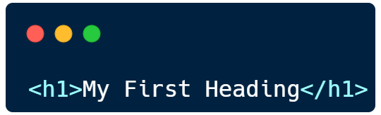

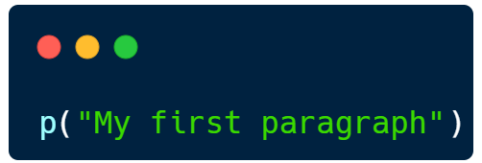
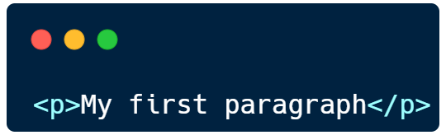
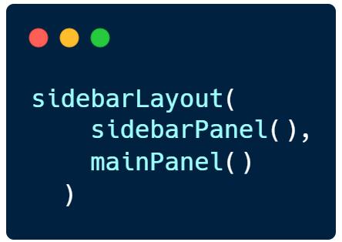
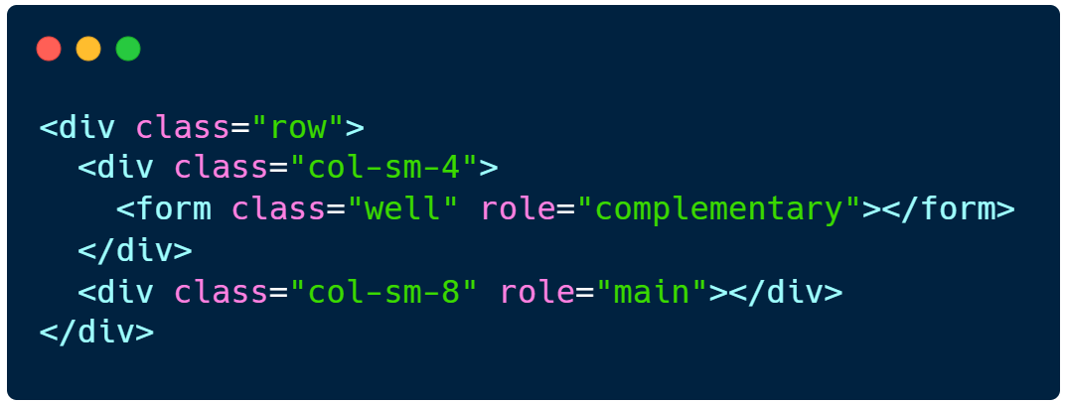
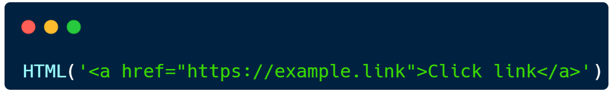
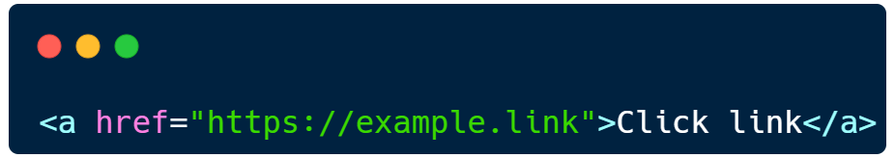
Shiny X HTML
Shiny
HTML

Slide 7
HyperText Markup Language
HTML stands for Hyper Text Markup Language
Standard markup language for creating Web pages
Describes the structure of a Web page
Consists of a series of elements
Elements tell the browser how to display the content
HTML elements label pieces of content such as "this is a heading", "this is a paragraph", "this is a link", etc.

Slide 8
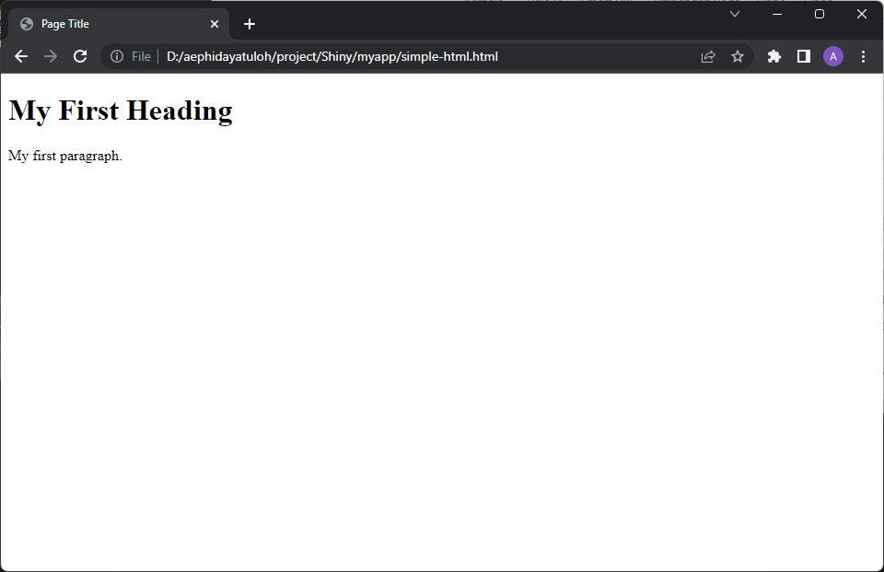
Simple HTML Document
<!DOCTYPE html>
<html>
<head>
<title>Page Title</title>
</head>
<body>
<h1>My First Heading</h1>
<p>My first paragraph.</p>
</body>
</html>

Slide 9
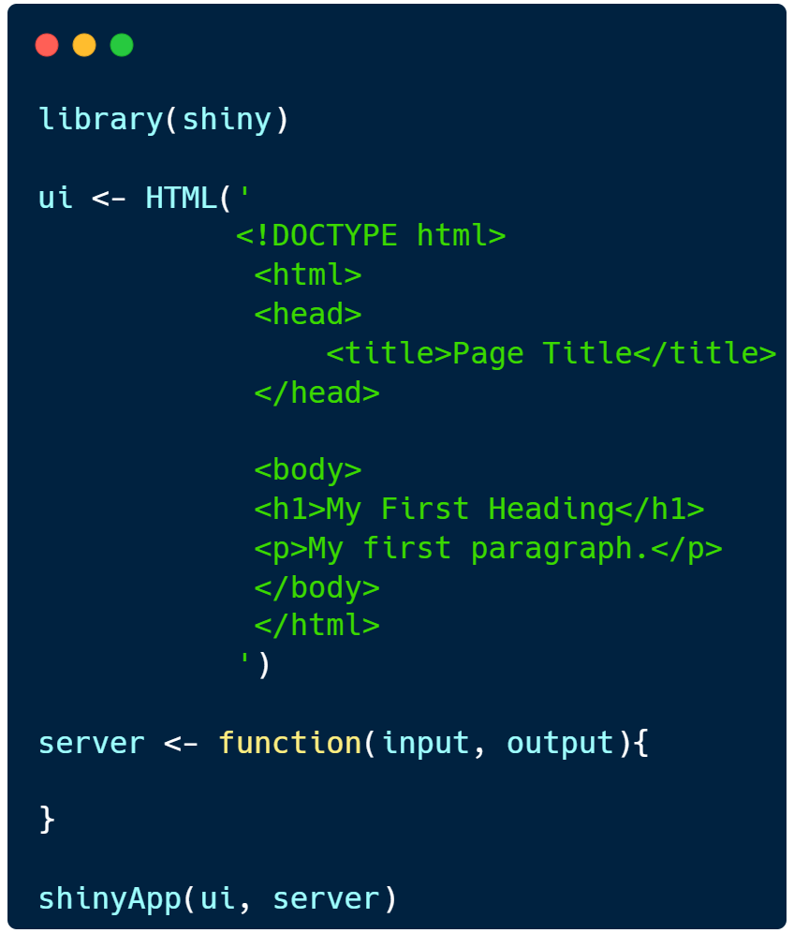
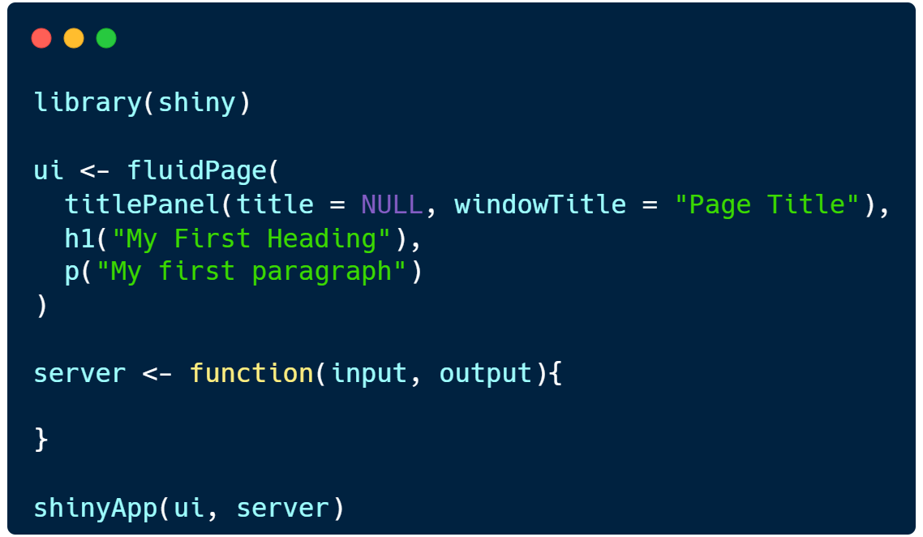
HTML as Shiny

Slide 10
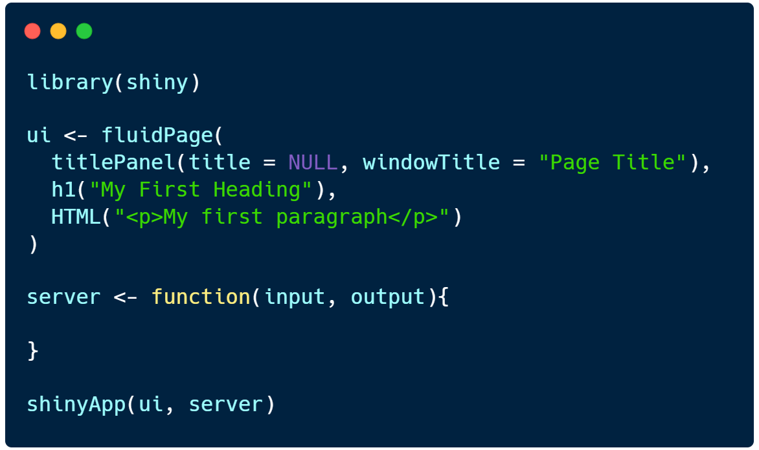
Shiny and HTML Combined

Slide 11
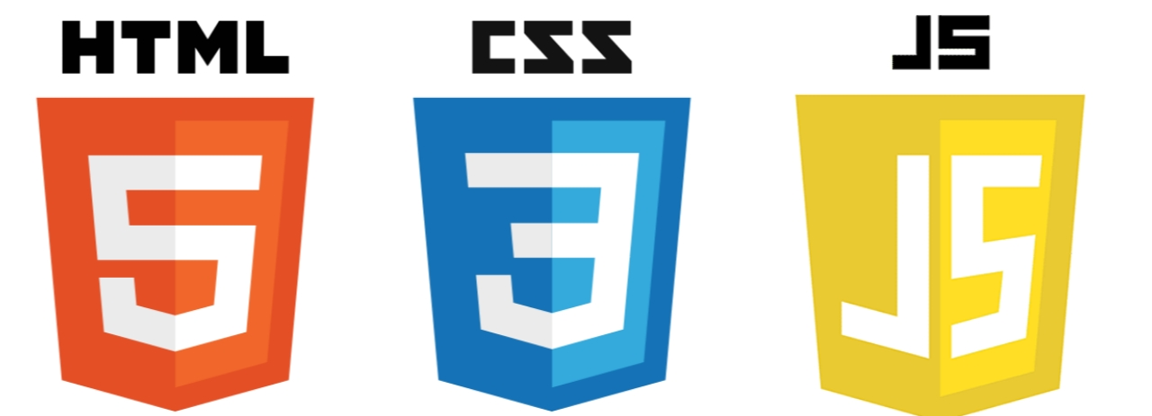

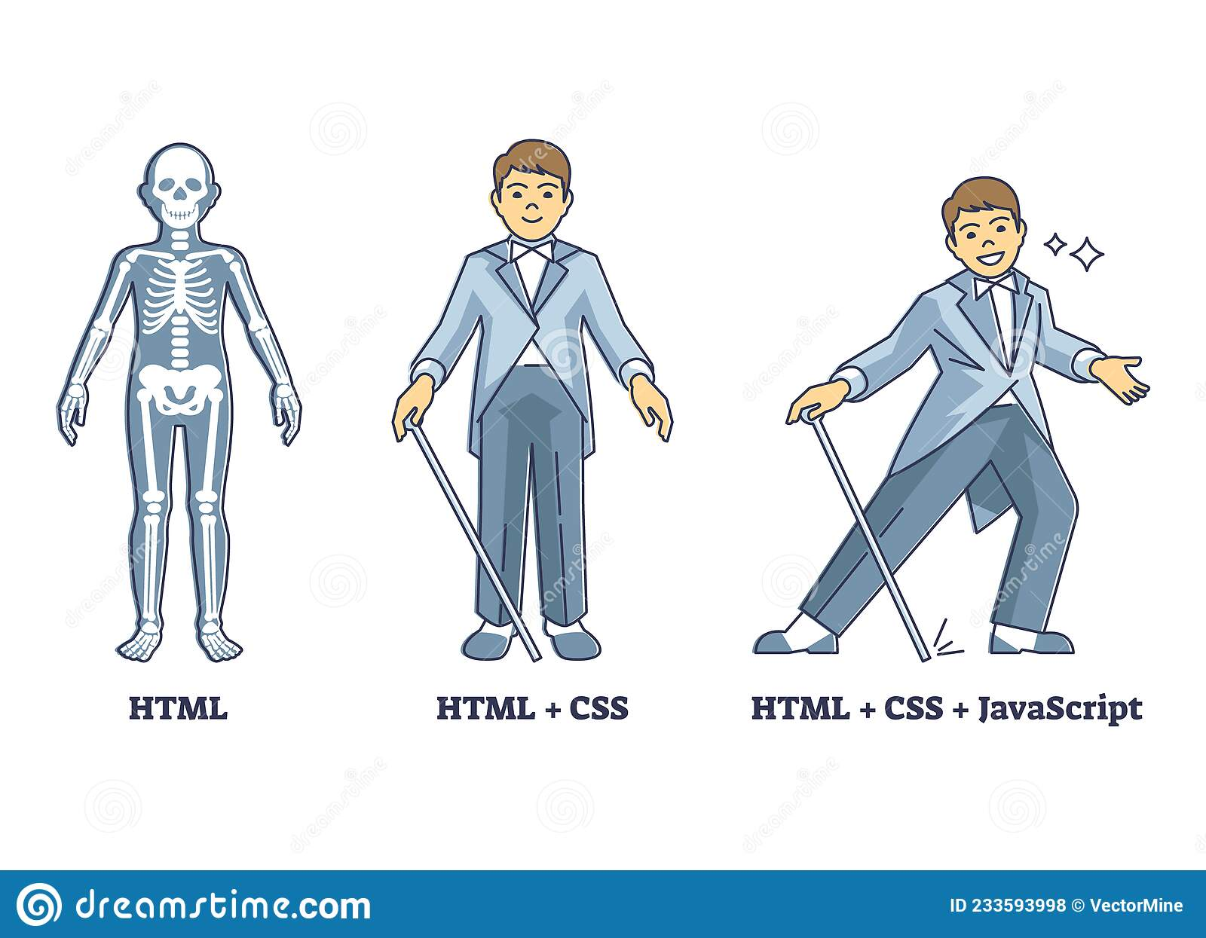


HTML X CSS X JavaScript
Bootstrap
CSS framework most widely used for web development
Tailwind CSS
Bulma
Shiny uses Bootstrap 3
(The world is on Bootstrap 5 now)

Slide 12
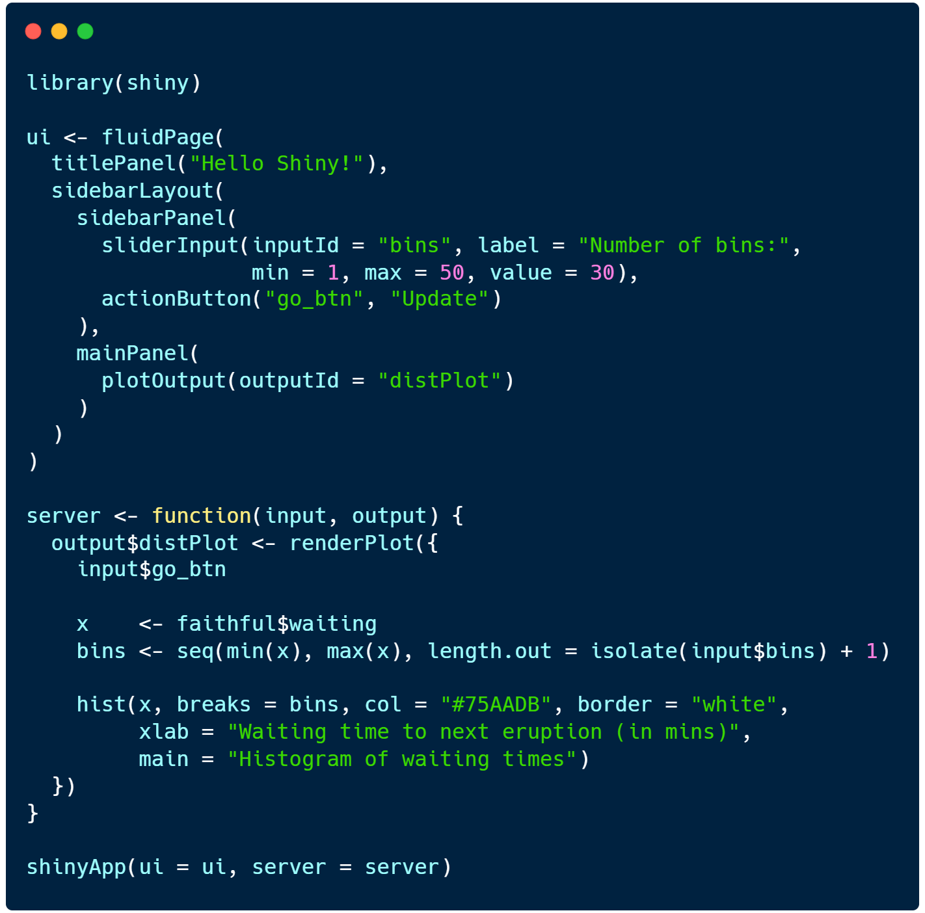
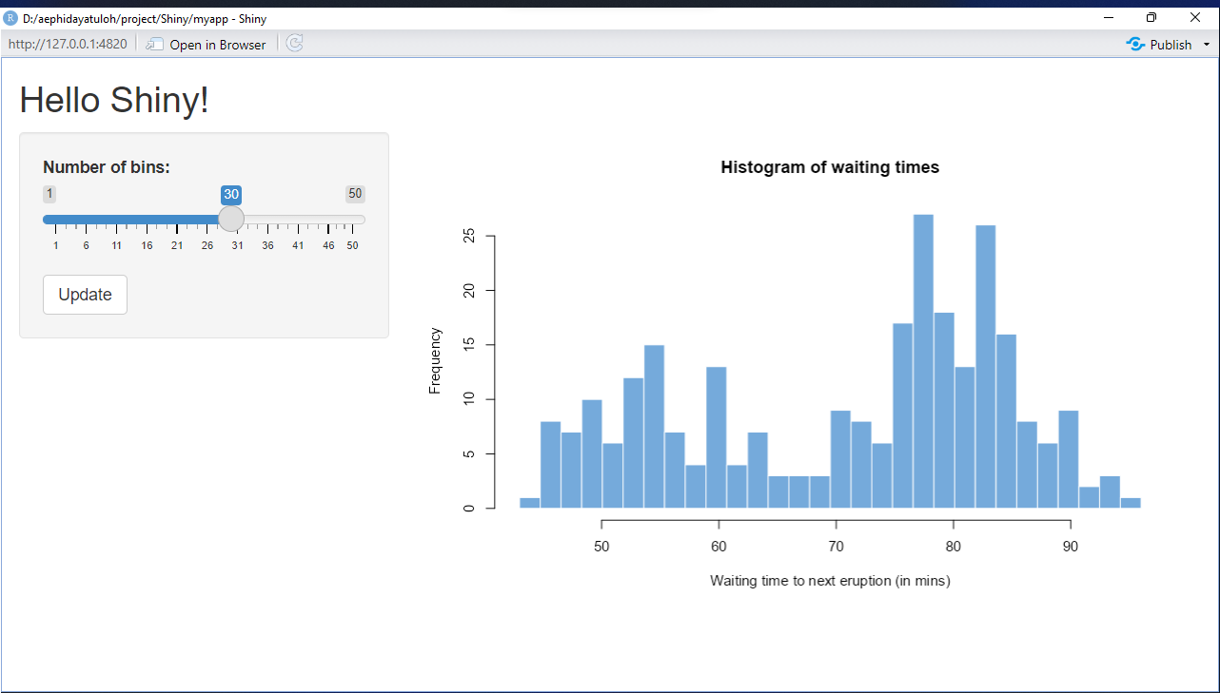
Styling Shiny App
Shiny Default

Slide 13
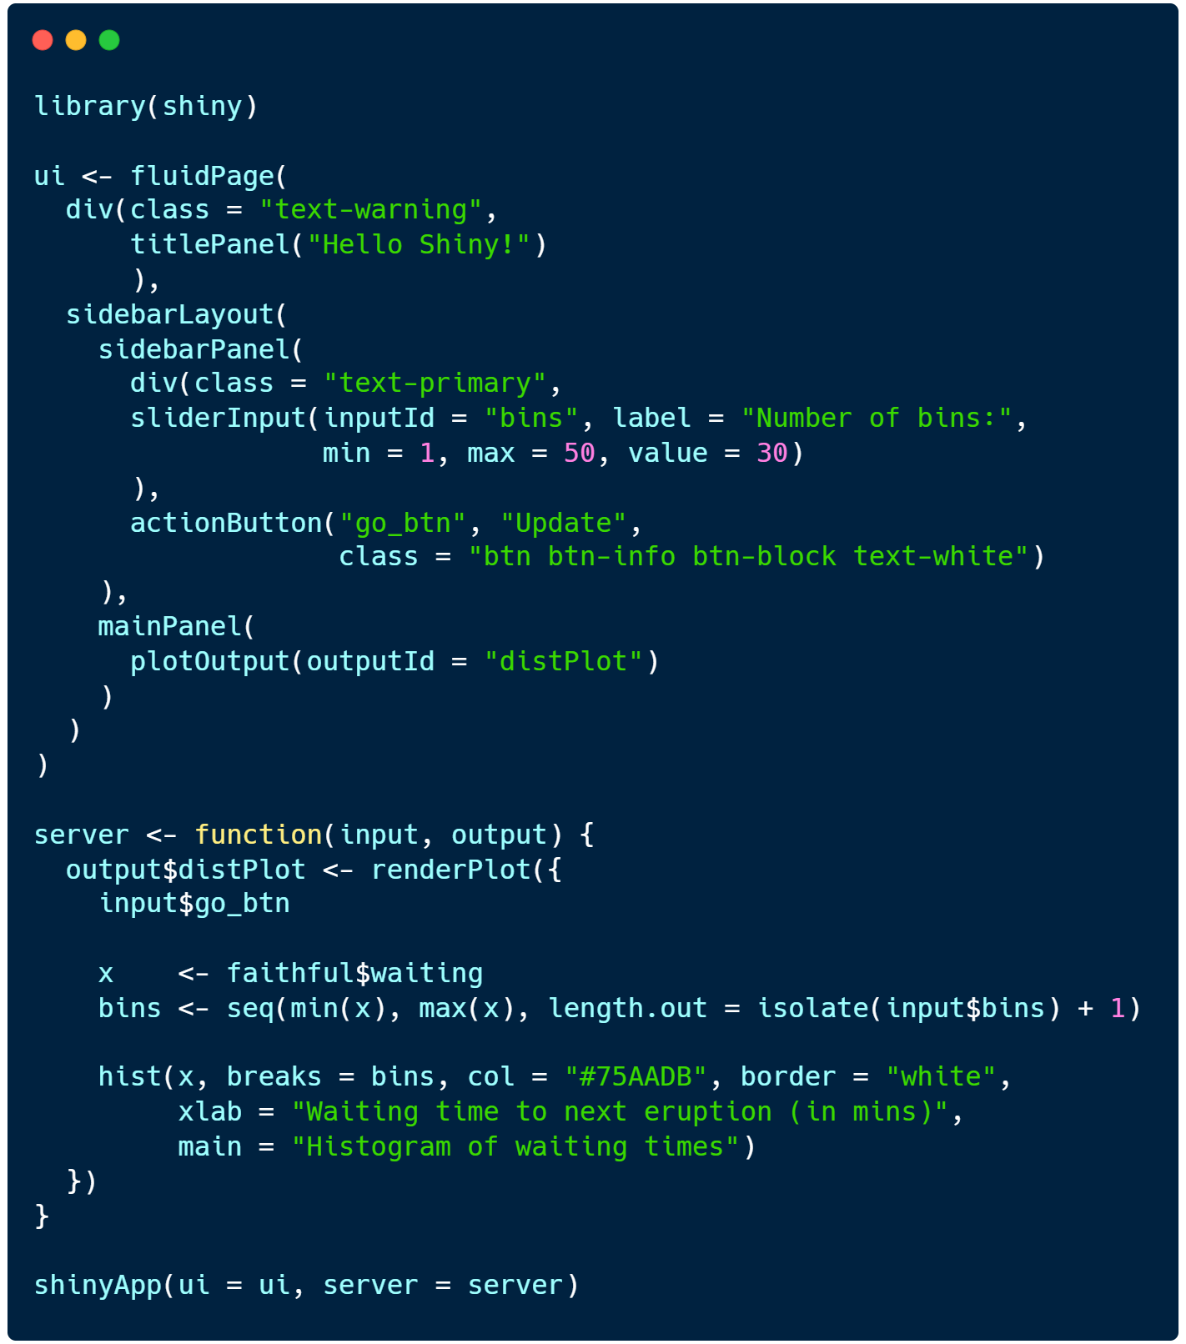
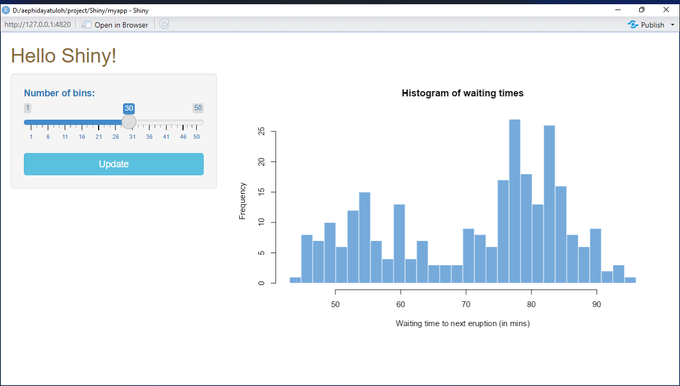
Styling Shiny App
Add Some CSS using class (and div)

Slide 14
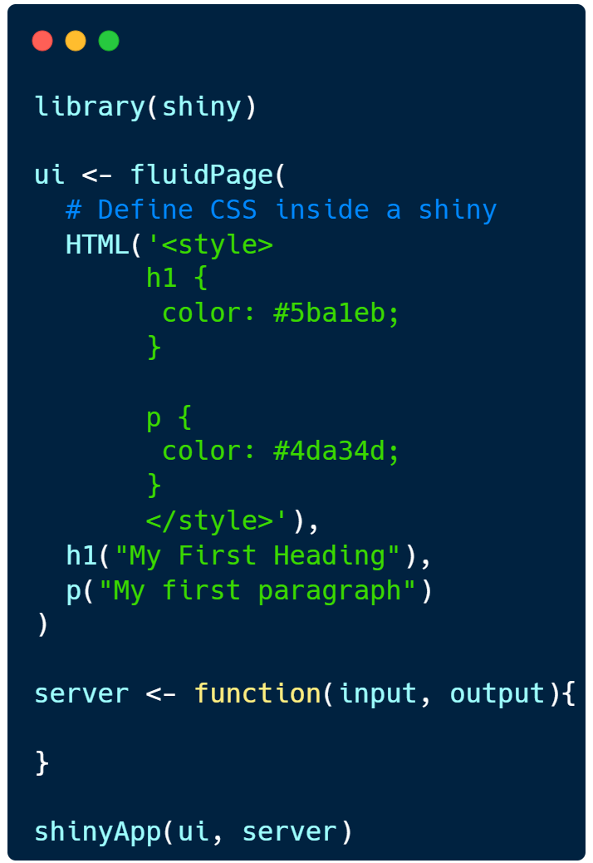
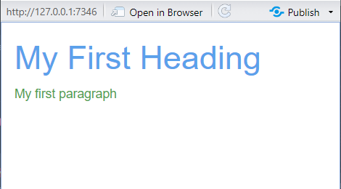
Styling Shiny App
Add Some CSS using class (and div)

Slide 15
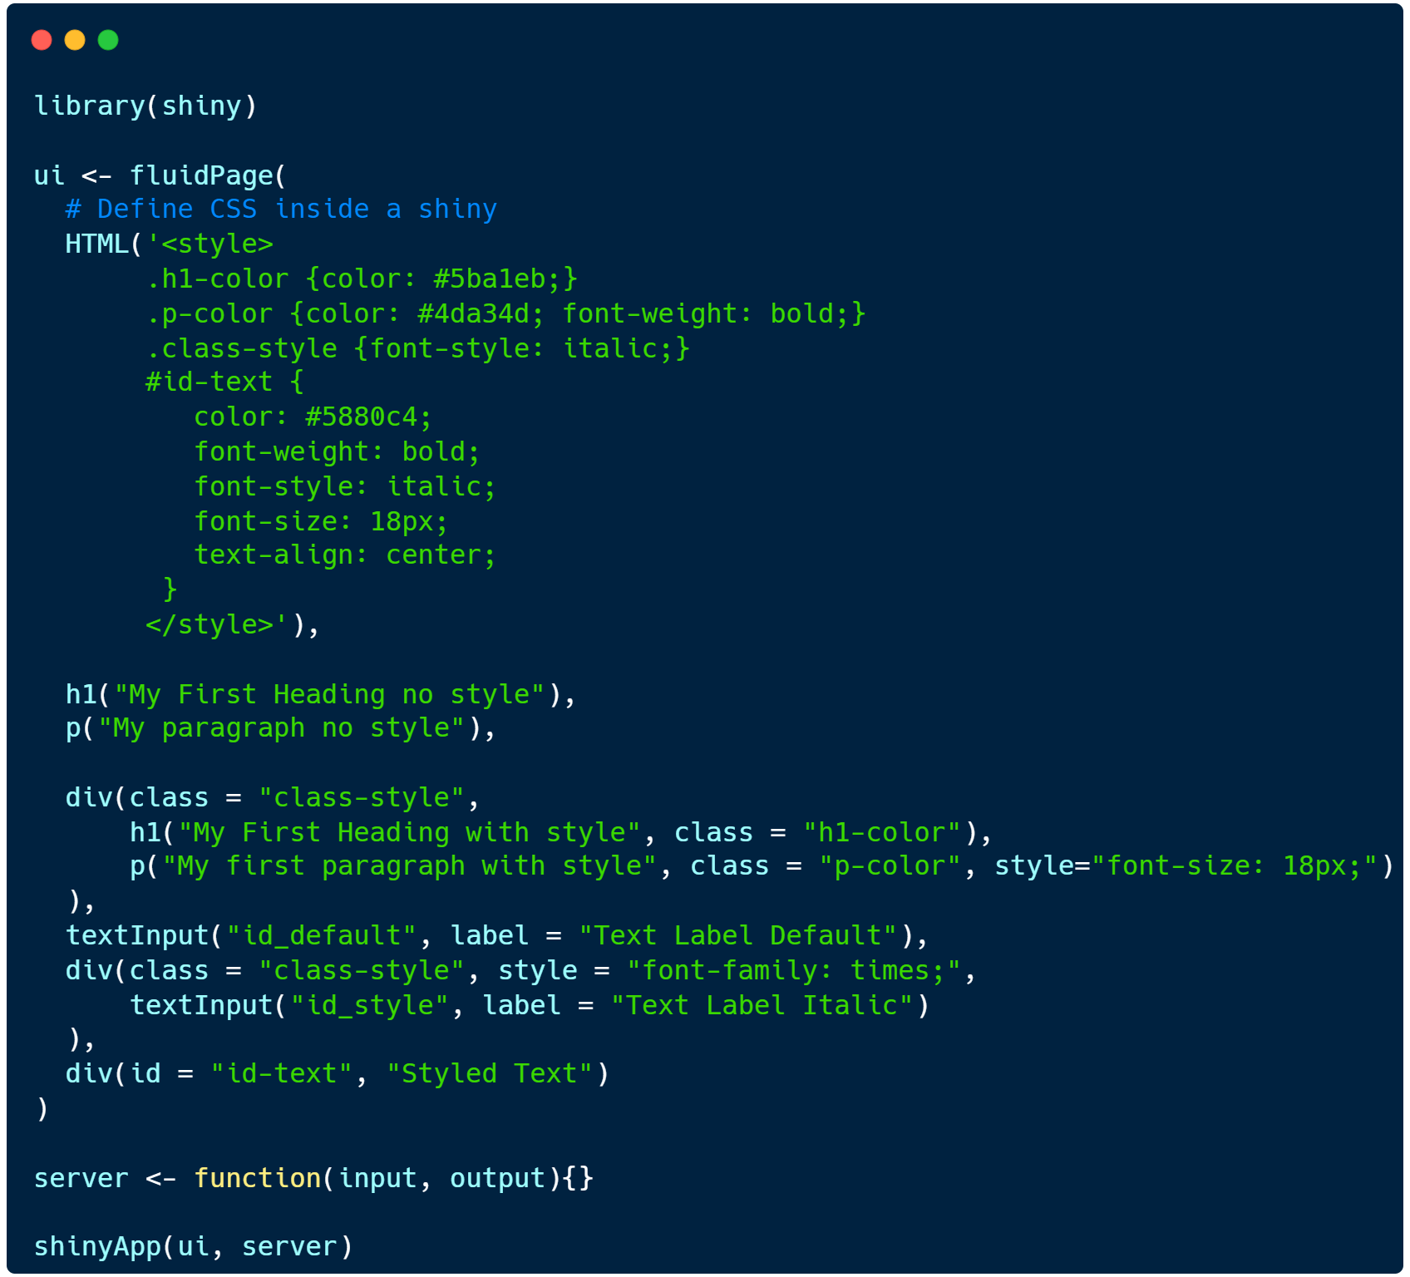
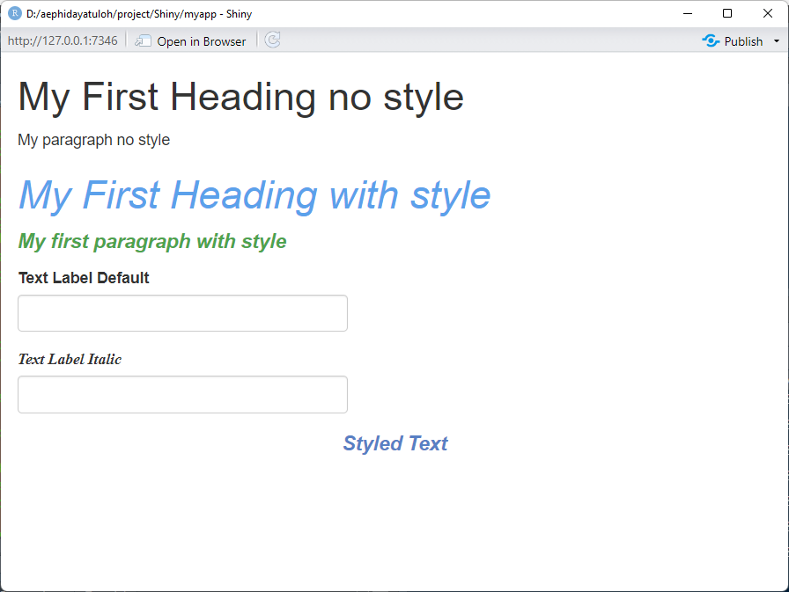
Styling Shiny App
Add Some CSS inside shiny using HTML

Slide 16
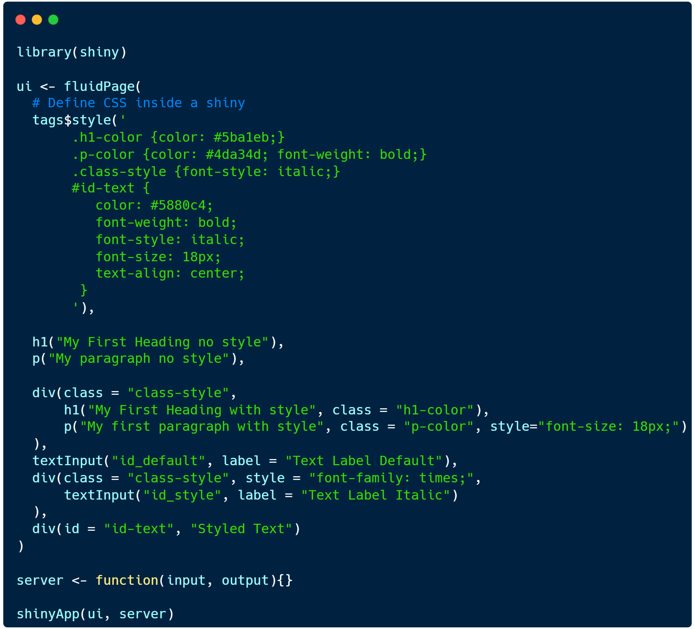
Styling Shiny App
Add Some CSS inside shiny using tags

Slide 17
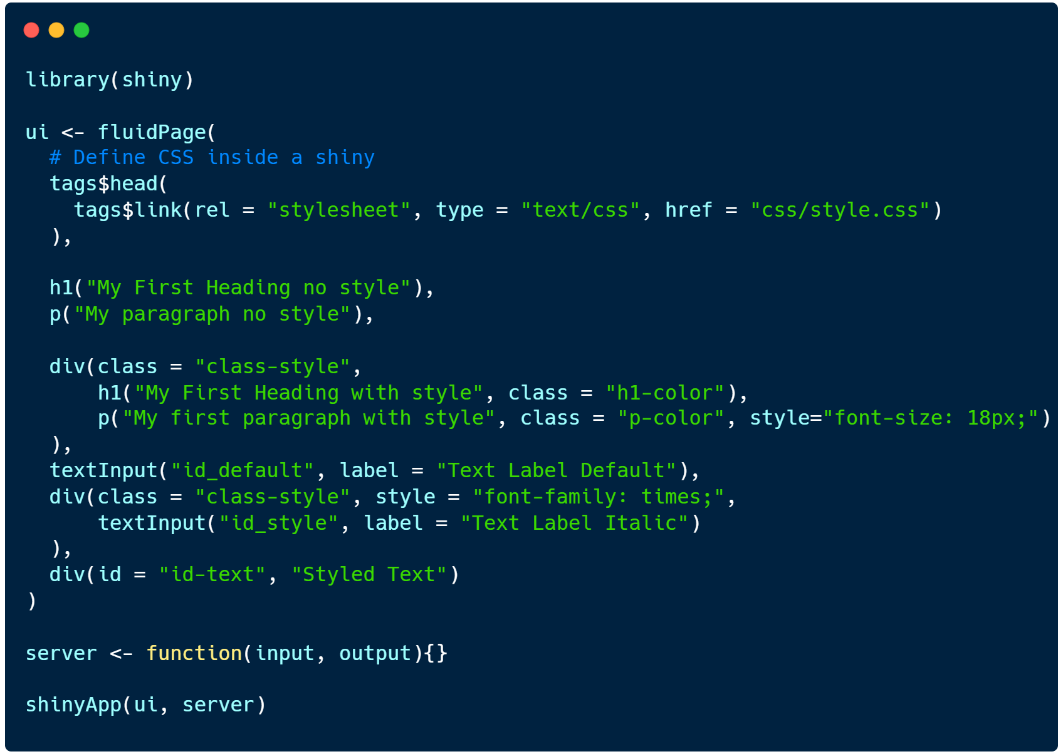
Styling Shiny App
Add Some CSS external file

Slide 18
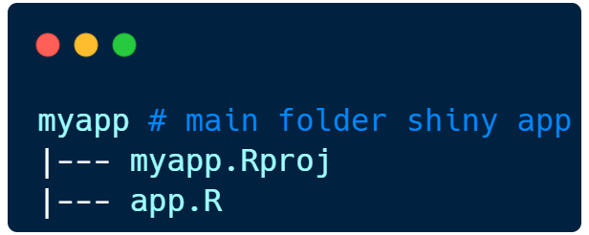
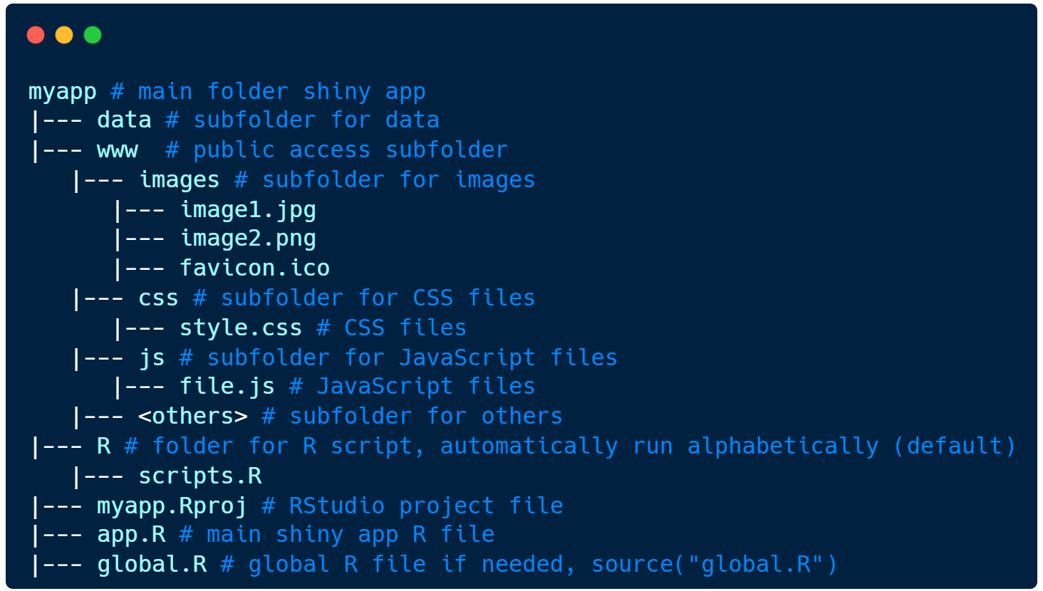
Restructure Shiny App

Slide 19
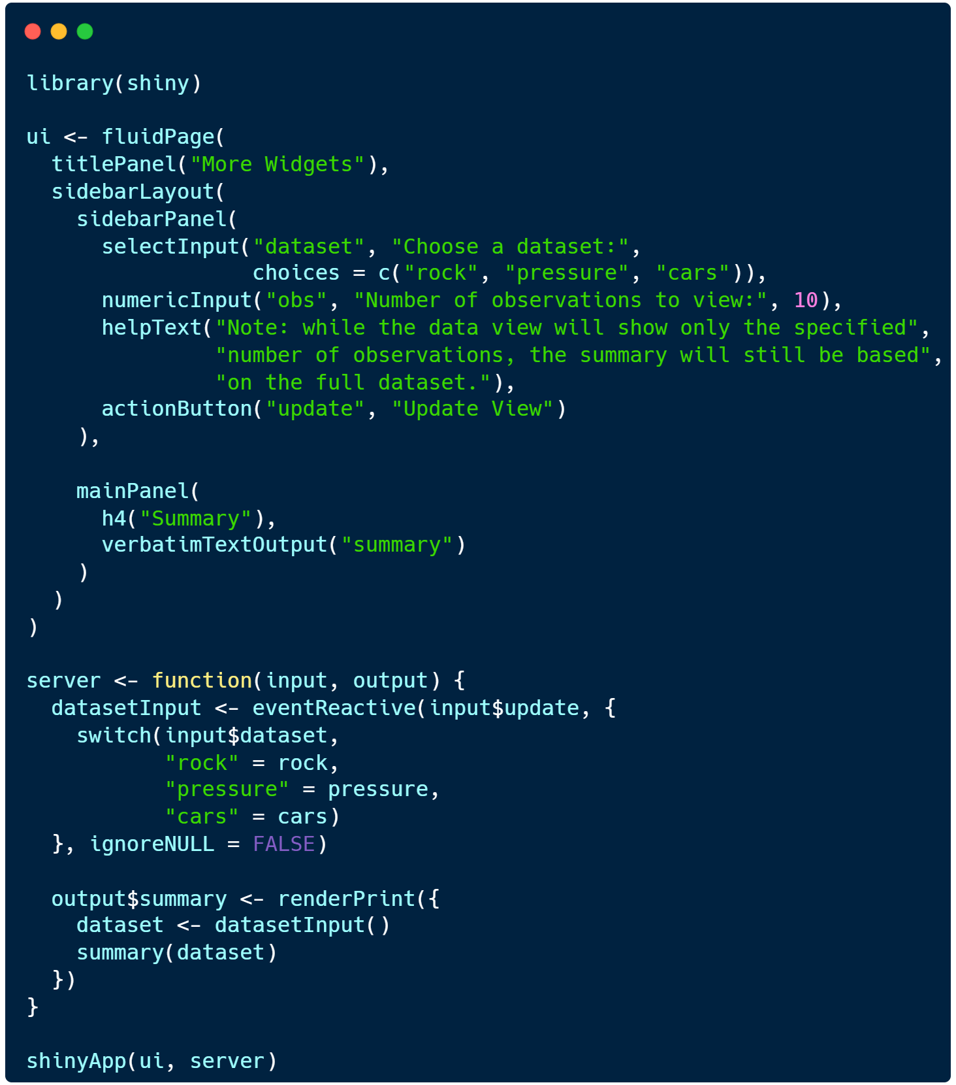
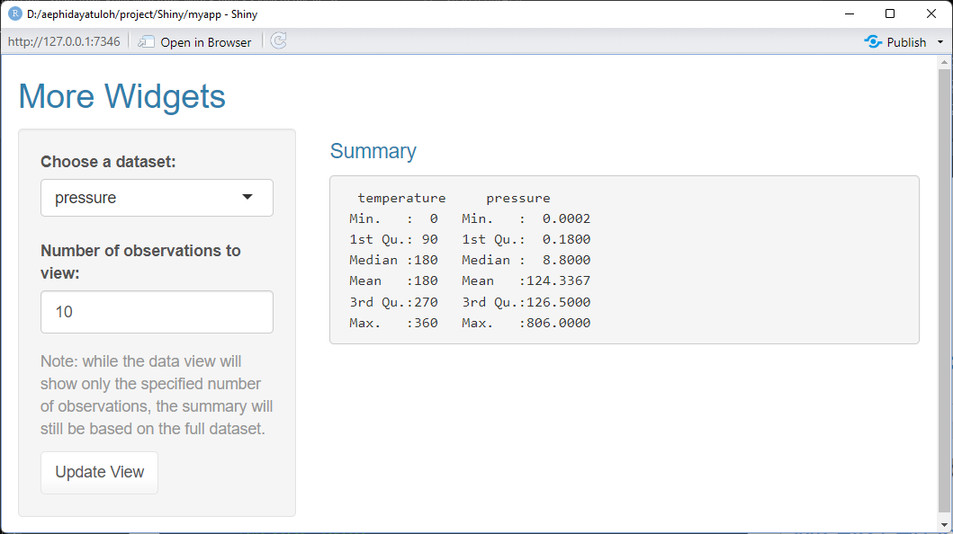
Shiny Default Theme

Slide 20
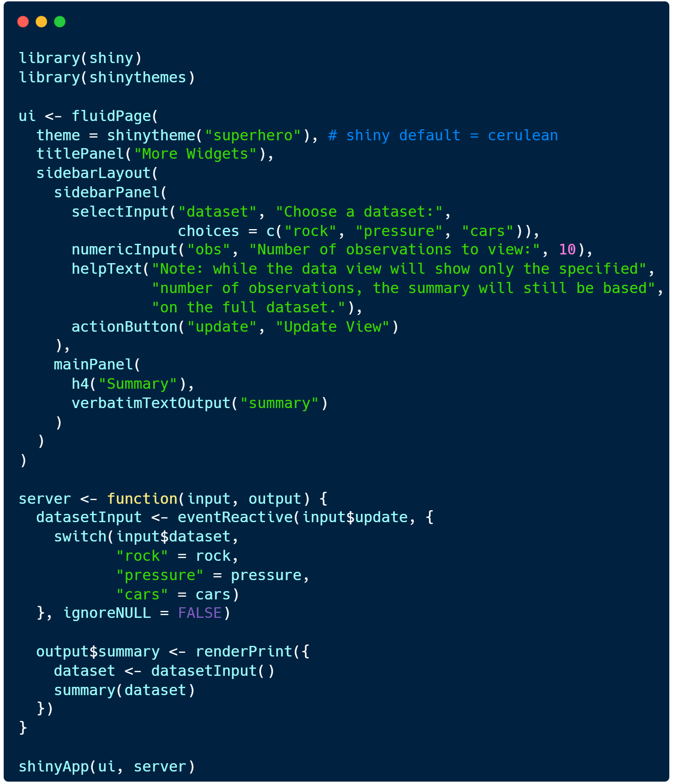
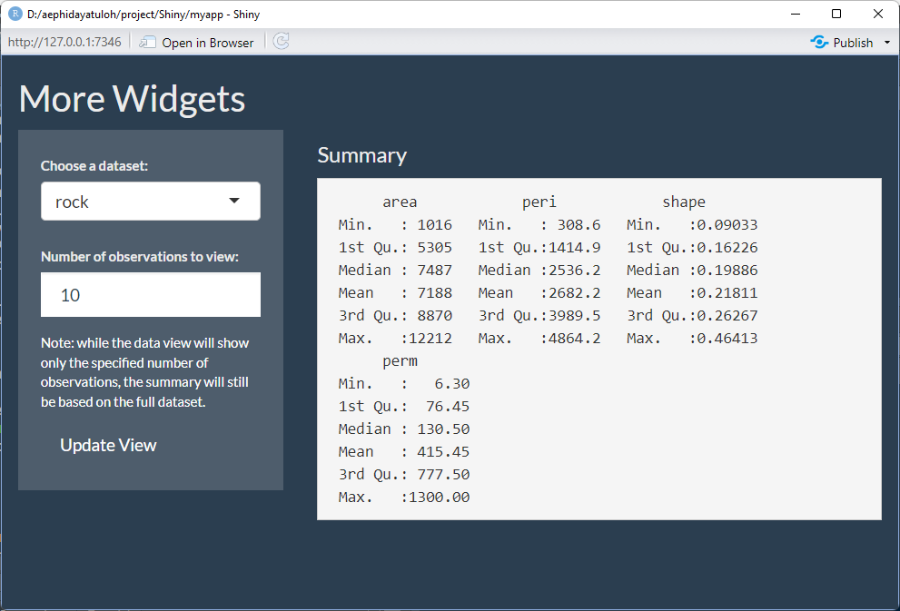
Use Shiny Template Package
{shinythemes}

Slide 21

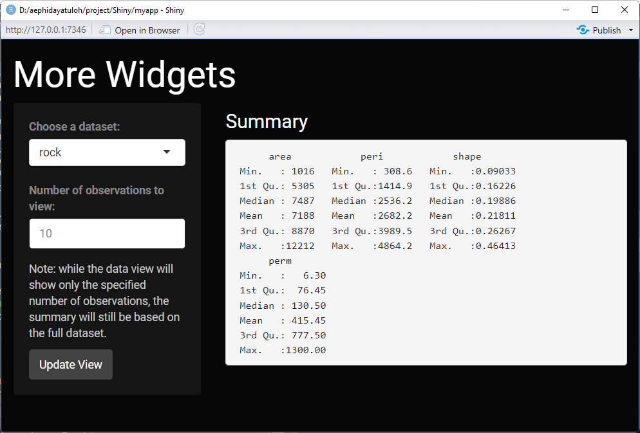
Use Shiny Template Package
{shinythemes}
Available theme:
cerulean, cosmo, cyborg, darkly, flatly, journal, lumen, paper, readable, sandstone, simplex, slate, spacelab, superhero, united, yeti

Slide 22
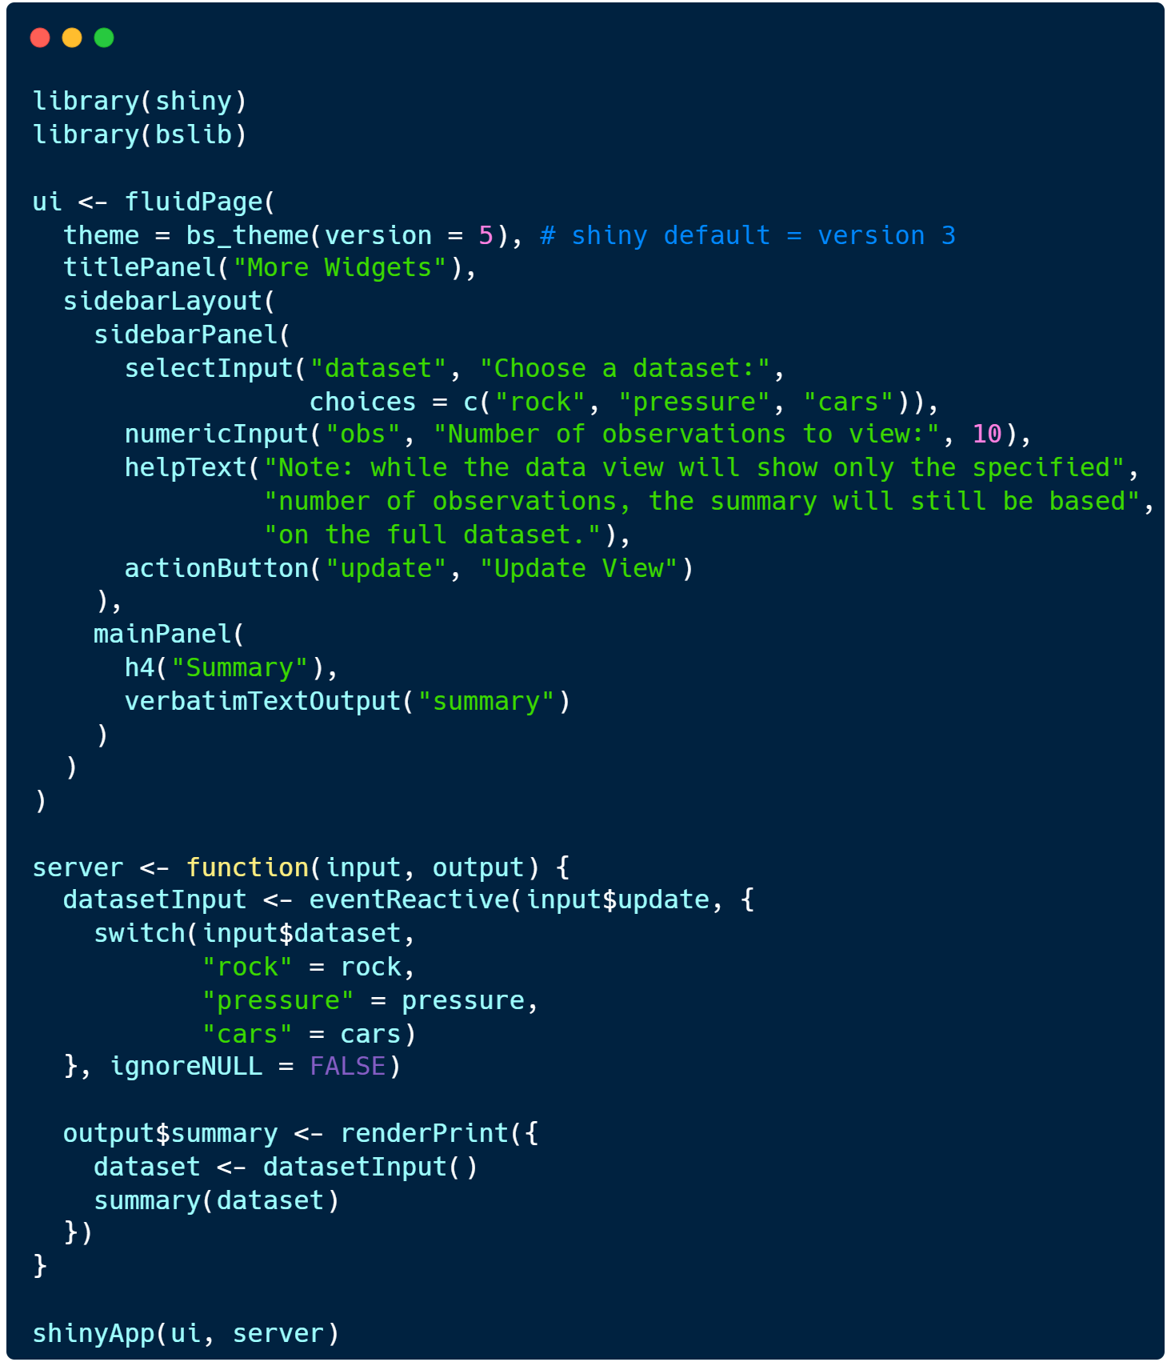
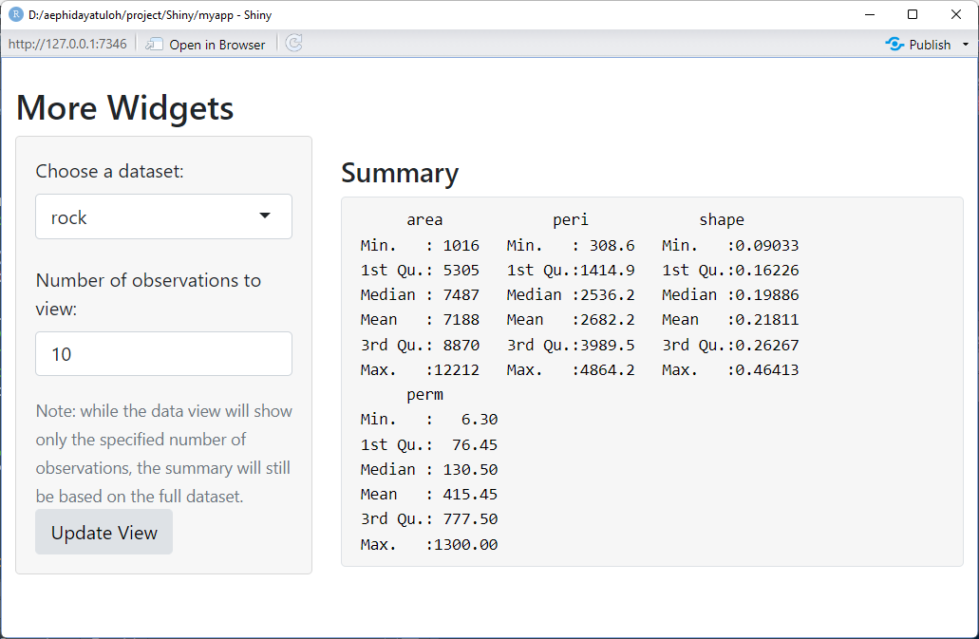
Use Shiny Template Package
{bslib}

Slide 23
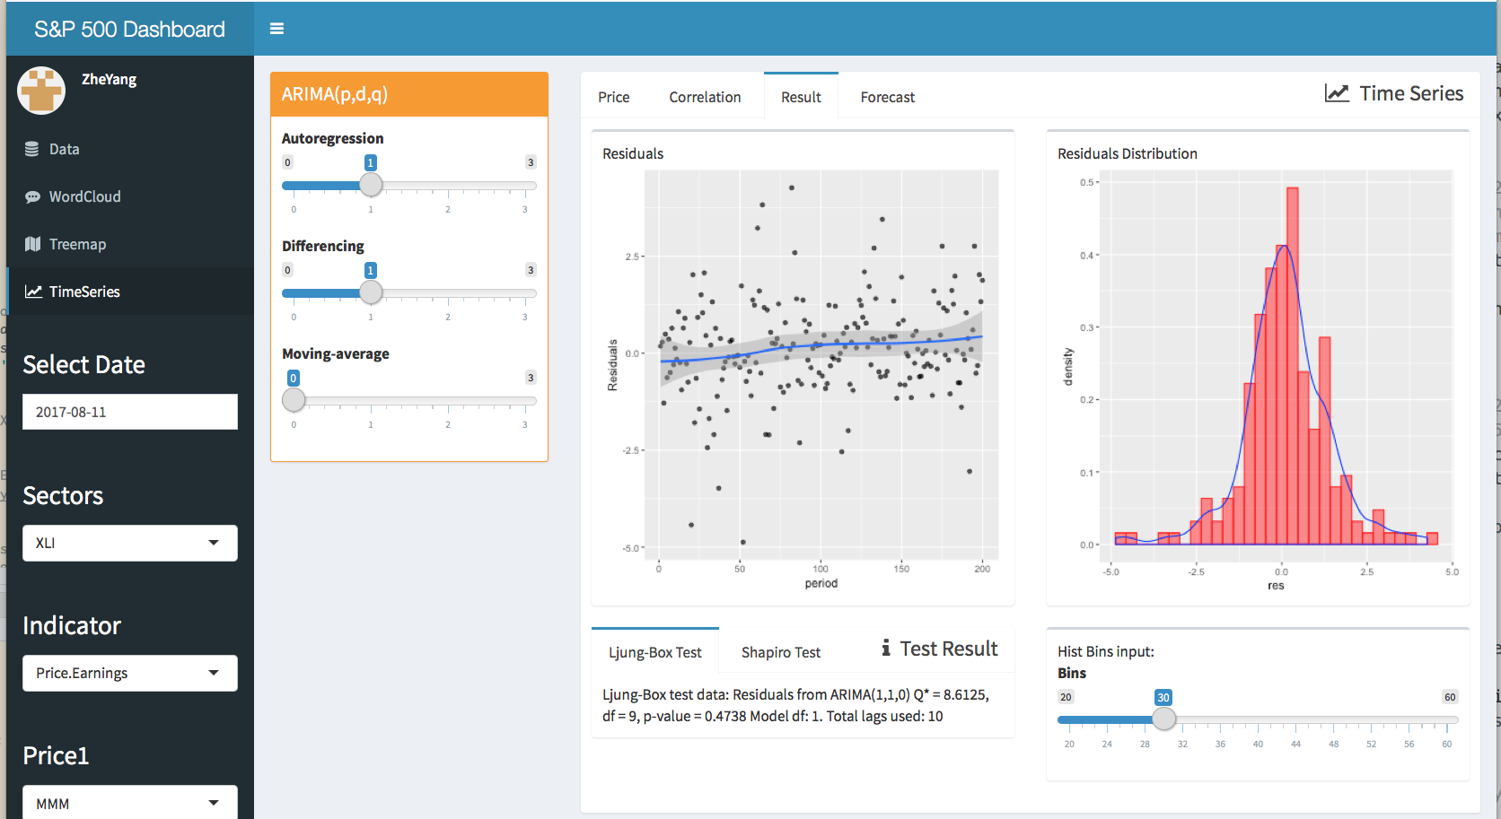
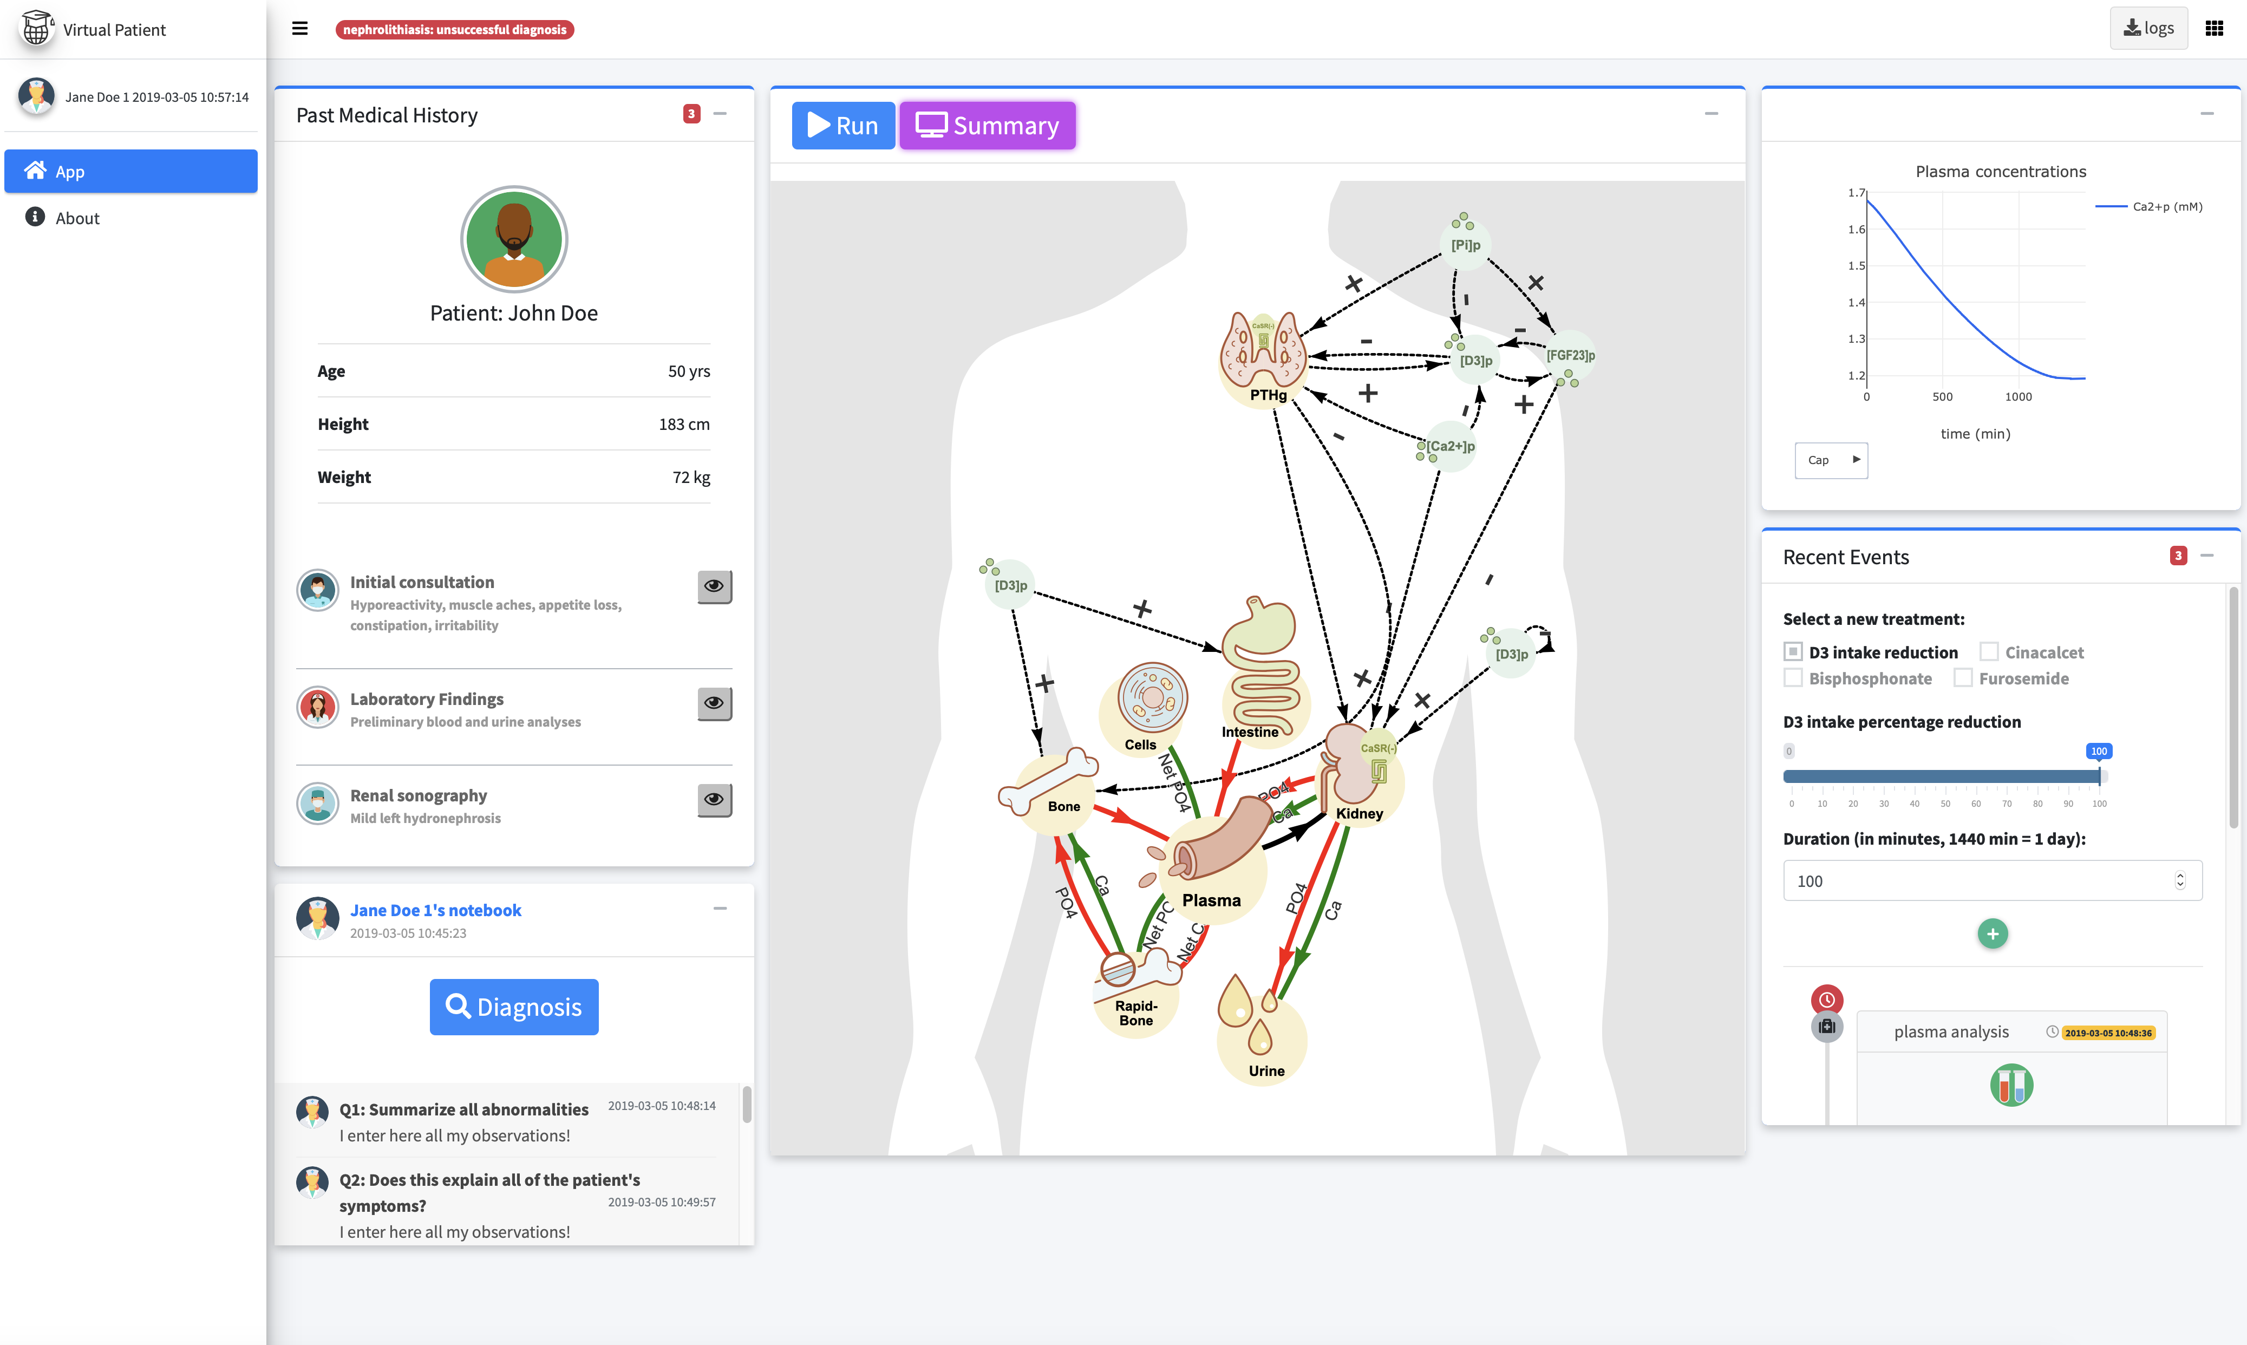
Use Shiny Template Package
{shinydashboard}
{bs4Dash}

Slide 24
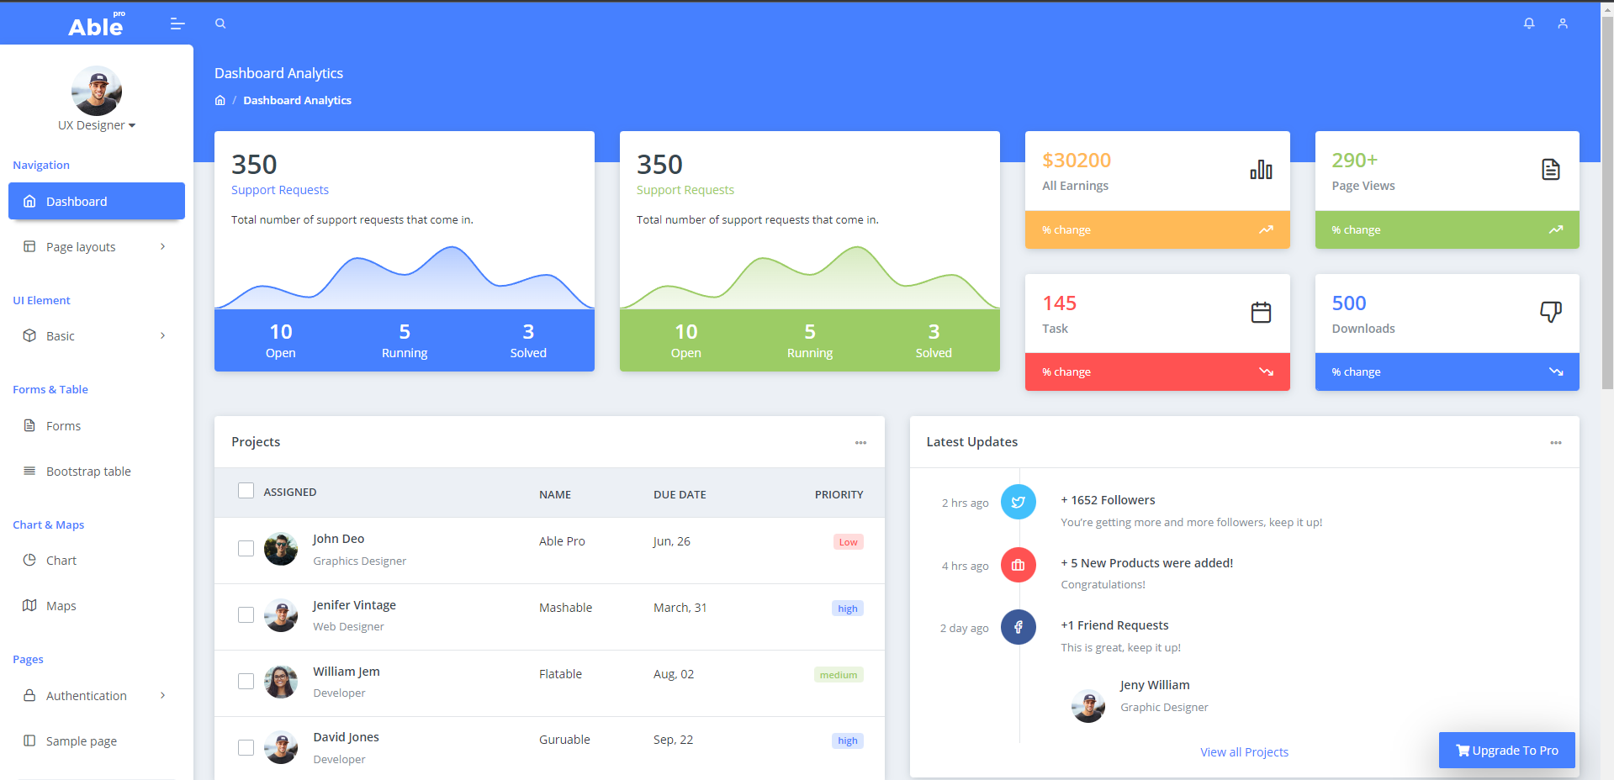
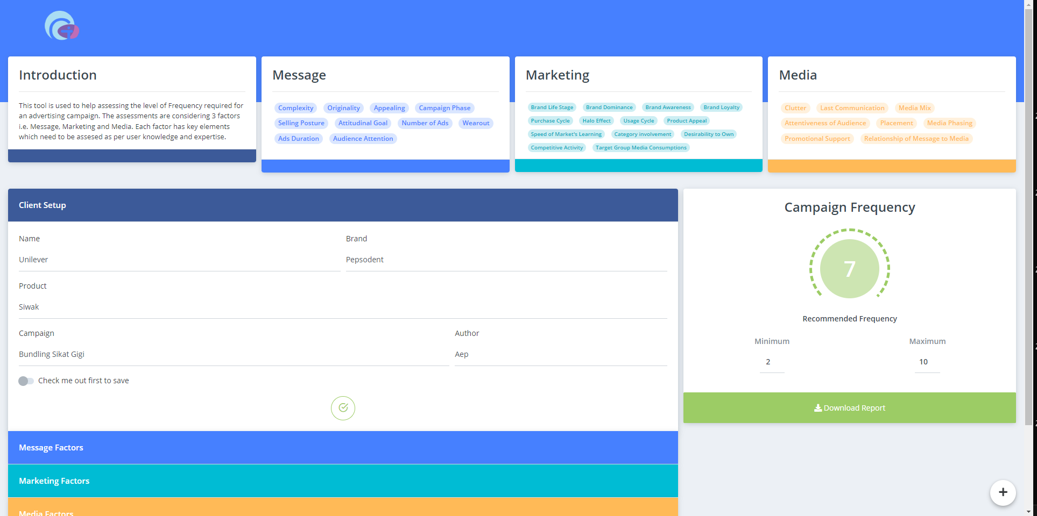
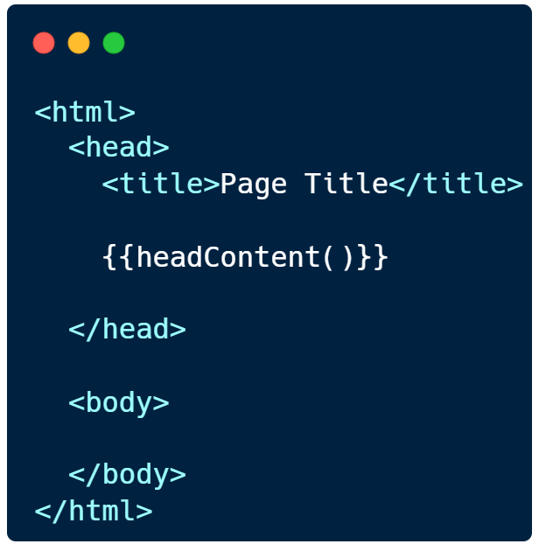
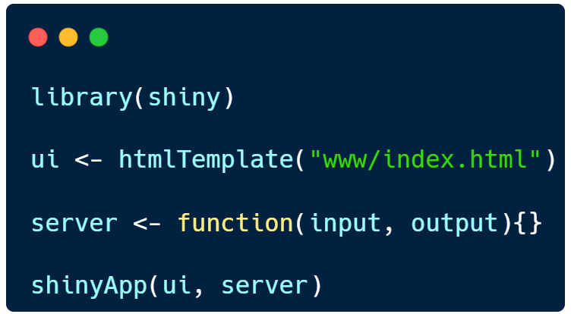
Use HTML Template
Edited
https://themewagon.com/themes/free-bootstrap-4-html5-admin-dashboard-template-able-pro-lite/

Slide 25
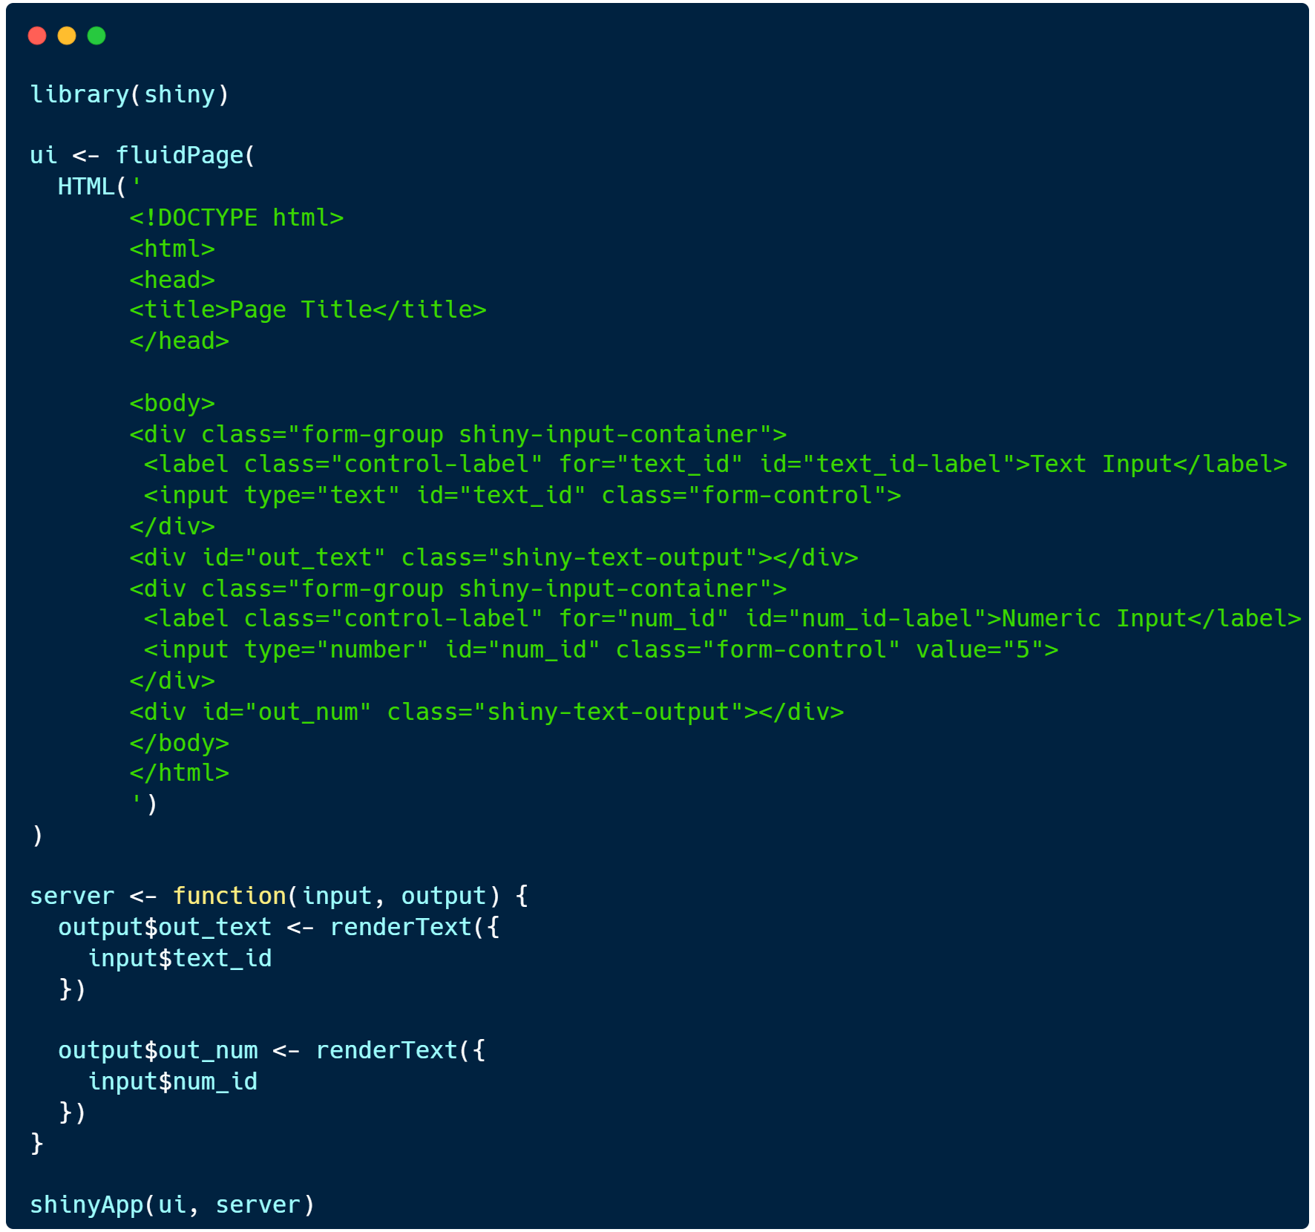
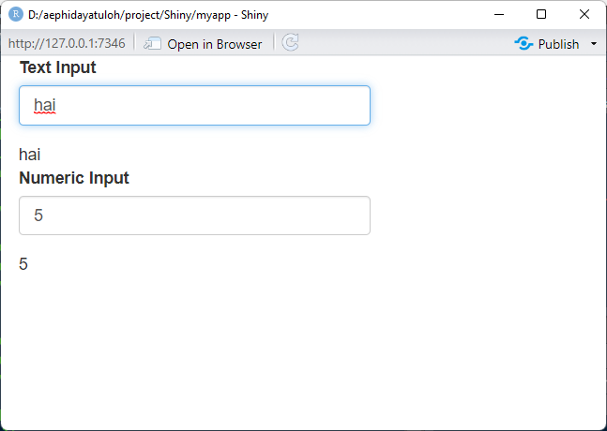
Create HTML + CSS

